Slide 1
Introduction to NMAP

Slide 2
Need for NMAP
Identifying open ports
Network Mapping
Auditing security

Slide 3

NMAP
Developed by Gordon Lyon
Features
Host discovery
Port scanning
Version detection
OS detection
Scriptable interaction with the target

Slide 4
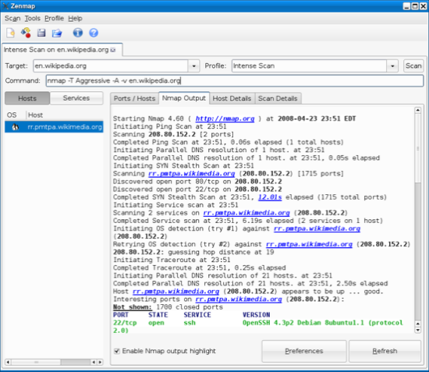
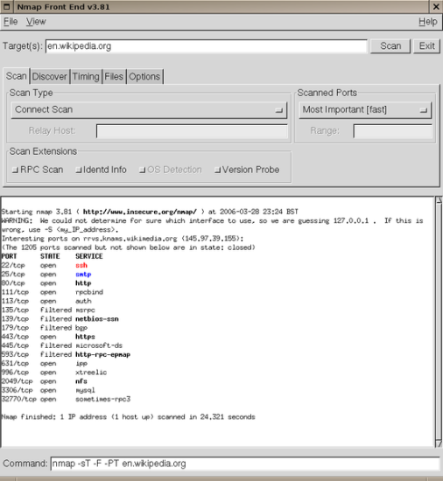
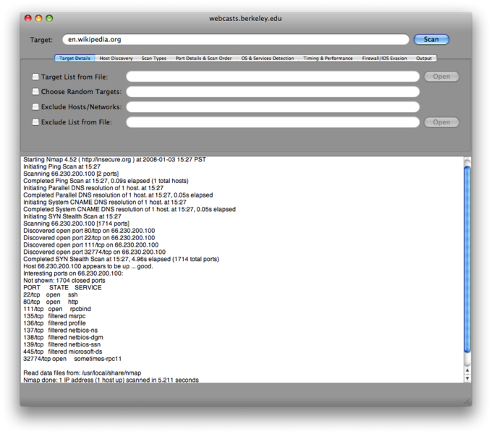
Environment & GUI
Runs on Linux, Windows, Mac OS X and other smaller operating systems
GUI options:
Zenmap
XNMap
NmapFE

Slide 5
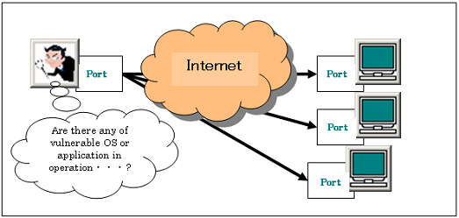
Port scanning

Slide 6
How NMAP Works
NMap pings the remote target with 0 byte packets to each port
If packets are not received back, port is open
If packets are received, port is closed
Sends different packets with different timing to determine filtered/unfiltered, version, etc.
Firewalls can interfere with this process

Slide 7
If port is Open
NMAP performs the scan by sending a SYN packet and look for the response. If SYN/ACK is received, the port is open.
The scanner then sends an RST to tear down the connection before it can be established fully

Slide 8
If port is Closed
If the port is closed, an RST will be sent.
If port is Filtered
If it is filtered, the SYN packet will have been dropped and no response will be sent

Slide 9
Ethical Issues
Can be used for hacking to discover vulnerable ports
System admins can use it to check that systems meet security standards
Unauthorized use of Nmap on a system could be illegal. Make sure you have permission before using this tool

Slide 10
NMAP work to solve
Find the system and services on the network
Discover information about these systems
Reliable tool for system admin, security professional and hobbyists
Accurate results in scanning

Slide 11
NMAP – Legal considerations in performing scanning
Is network scanning legal?
It depends
Legal if you scan your own network with explicit permission
Illegal if you scan without any permission

Slide 12
Laws by country
Differ from country to country
Safety bet is to scan the system which own with prior permission
Think about the target which you want to perform scanning
Can be considered as illegal and it depends on how you use them?

Slide 13
Network Port
Interface to the application available to the network
Represented by the number
Web servers – TCP (80/443)
Email servers – TCP (25,110,143 etc.,)
DNS servers – UDP (53)

Slide 14
TCP 3 way handshake
SYN
SYN+ACK
ACK

Slide 15
List of Scans in NMAP
Intense scan -Should be reasonable quick, scan the most common TCP ports, OS, Services and Versions
Intense scan plus UDP- Same as the regular Intense scan, also scan UDP ports
Intense scan, all TCP ports-Normally Nmap scans a list of 1000 most common protocols, but instead we will in this example scan everything from port 1 to 65535 (max).

Slide 16
List of Scans
Intense scan, no ping – Similar to other intense scans, however this will assume the host is up. Useful if the target is blocking ping request and you already know the target is up.
Ping scan- Do only a ping only on the target, no port scan.
Quick scan- Scan faster than the intense scan by limiting the number of top 100 TCP ports.

Slide 17
List of Scans
Quick scan plus –Widely used for OS detection and you got the Quick scan plus.
Quick traceroute – Used to determine hosts and routers in a network scan
Regular scan - Default everything. ICMP Echo request (ping) for host detection. Scans 1000 TCP ports
Slow comprehensive scan – Similar to intense scan plus UDP. It uses all the three protocols to detect the hosts, TCP, UDP and SCTP

Slide 18
Host discovery
Nmap –sP 192.168.108.1/24
Wireshark
Sniff on eth0
Ip.addr==192.168.108.1

Slide 19
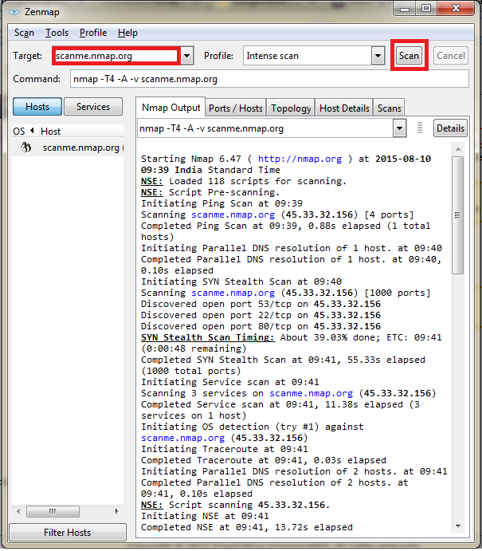
Zenmap – A GUI of NMAP

Slide 20
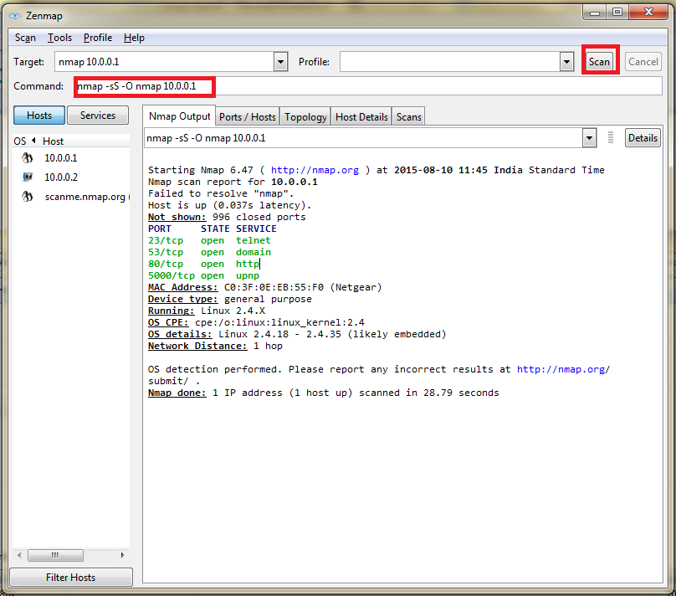
OS detection

Slide 21
Exercises
Identify Which hosts are up now? Apply ping sweeping
nmap -sn 10.0.0.1/24
Use the TCP "ping" option with a ping scan with a flag to target port
nmap -sn -PA80 10.0.0.0/24
To scan all the TCP ports
nmap -p 1-65535 192.168.108.1

Slide 22
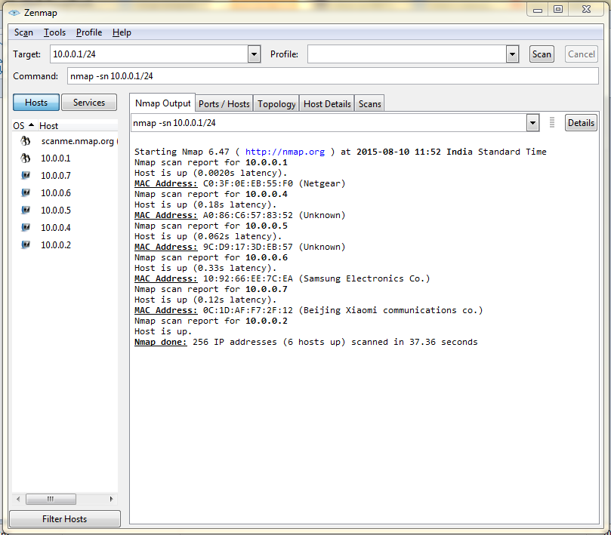
Results Port Sweeping

Slide 23
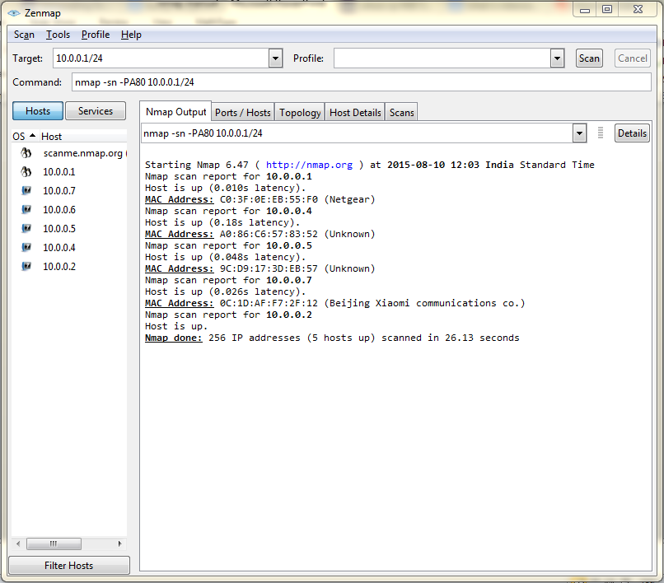
ping scan at port 80

Slide 24
Ping sweep
nmap –sP –oG ping-sweep 192.168.108.1
nmap -sP -oN sibi 192.168.108.1/24

Slide 25
Saving in xml file
Nmap –oX xml-dump 192.168.108.1

Slide 26
Reason flag in your scan
nmap -sU --reason 172.168.89.191

Slide 27
Find out if a host/network is protected by a firewall
nmap -sA 172.168.1.254

Slide 28
Scan a host when protected by the firewall
nmap -PN 172.168.1.1

Slide 29
Scan a firewall for security weakness
nmap -sN 172.168.1.254 //No flag bits are set
nmap -sF 172.168.1.254 // sets FIN flag
nmap -sX 172.168.1.254 //sets FIN, PSH, URG

Slide 30
Cloak a scan with decoys
nmap -n -Ddecoy-ip1,decoy-ip2,your-own-ip,decoy-ip3,decoy-ip4 remote-host-ip
nmap -n -D192.168.1.5,10.5.1.2,172.1.2.4,3.4.2.1 192.168.1.5

Slide 31
Firewall bypass (locally)
Scan → MAC address spoofing
nmap --spoof-mac MAC-ADDRESS-HERE 172.168.1.1
nmap -v -sT -PN --spoof-mac MAC-ADDRESS-HERE 172.168.1.1
nmap -v -sT -PN --spoof-mac 0 172.168.1.1

Slide 32
Firewall bypass
nmap -sS -P0 172.168.89.191

Slide 33
Firewall bypass
nmap --script firewall-bypass --script-args firewall-bypass.helper="ftp", firewall-bypass.targetport=22 172.18.232.1
nmap --script firewall-bypass 172.18.232.1

Slide 34
Version info
nmap -V 172.168.89.191

Slide 35
Shodan-api key
nmap --script shodan-api x.y.z.0/24 -sn -Pn -n --script-args 'shodan-api.apikey=SHODANAPIKEY'
nmap --script shodan-api x.y.z.0/24 -sn -Pn -n --script-args 'shodan-api.apikey= <key>'

Slide 36
virustotal
nmap --script http-virustotal --script-args='http-virustotal.apikey="<key>",http-virustotal.checksum="275a021bbfb6489e54d471899f7db9d1663fc695ec2fe2a2c4538aabf651fd0f"'

Slide 37
Checks if a web server is vulnerable to directory traversal by attempting to retrieve /etc/passwd or \boot.ini.
nmap --script http-passwd --script-args http-passwd.root=/test/ <target>

Slide 38
Tests a web server for vulnerability to the Slowloris DoS attack by launching a Slowloris attack.
nmap --script http-slowloris --max-parallelism 400 <target>

Slide 39
Google safe browsing api
nmap –p80 --script http-google-malware --script-args http-google-malware.api=<api> target

Slide 40
Grep (ing) public emails using nmap
nmap -p <Port> --script http-grep <target>
nmap –p443 --script http-grep <target>

Slide 41
Discovering hostnames pointing to the same IP address
nmap -sn --script hostmap-* <target>

Slide 42
Discovering hostnames by brute forcing DNS records
nmap --script dns-brute –p80 172.18.232.10
nmap --script dns-brute --script-args dns-brute.domain=foo.com,dns-brute.threads=6,dns-brute.hostlist=./hostfile.txt,newtargets -sS -p80 172.18.232.10

Slide 43
Validate your network broadcast
nmap --script broadcast-listener -e eth0

Slide 44
Lab Questions
In the LAN, how many hosts are running? Please list their IP addresses.
If a computer is up, which services (TCP and UDP) are open on it?
Can you determine the Operating system and its possible version that is running on each alive computer?

Slide 45
NMAP Scripting Engine
To perform more complex checks
To infer more information
To allow for greater flexibility

Slide 46
NSE
The basic structure of an NSE script
Required components of an NSE script
Useful libraries
Portrules

Slide 47
NSE Structure
The Head
The Rule
The Action

Slide 48
Script Categories
Auth
Broadcast
Brute
Default
Discovery
DoS
Exploit
Intrusive
Malware
Safe
Version
Vuln

Slide 49
NSE Libraries
128 NSE libraries built into NMAP
Nmap
Nsedebug
Shortport
Smb
Vulns
……..

Slide 50
Importing Libraries
Head Section
Local shortport = require “shortport”
Local http = require “http”
Local stdnse = require “stdnse”

Slide 51
Building portrules
Portrule = function (host,port)
Local auth_port = {number =113, protocol =“tcp”}
Local identd = nmap.get_port_state(host,auth_port)
Return identd~=Nil and identd.state == “open” and port.protocol == “tcp” and port.state == “open”
End

Slide 52
Port rules simplified
--Head
Local shortport = require “shortport”
--Rule
Portrule = shortport.http

Slide 53
Windows Service Identification
nmap -PS445 -p445 --script=smb-os-discovery,smbv2-enabled,smb-enum-shares,smb-ls --script-args=ls.maxdepth=10 192.168.108.99

Slide 54
Heart bleed Vulnerability
nmap -d sC --script ssl-heartbleed.nse www.mitindia.edu

Slide 55
Win32 Services
nmap -d sC --script snmp-win32-services.nse 192.168.108.99

Slide 56
WCRY - SMB vuln
nmap –d -sC -p 445 --script smb-vuln-ms17-010.nse 192.168.108.99

